Slide 1



Software engineering (Undergraduate)
Chapter 3 process framework
Course Name software Development project management
CSC 4125
(Undergraduate)
M. Mahmudul hasan
Assistant Professor, CS, AIUB
http://www.dit.hua.gr/~m.hasan

Slide 2
Introduction
All of the work that is done on a project is made up of processes
There is a pattern to all of the work that gets done on the project
Plan
Work
- Compare with the original plan - If off-plan, corrections are made and everything needs to get back on track
Process framework, Process groups, and Knowledge areas ensures project smoothness.

Slide 3
Process groups (PMBOK)
Process Groups are the steps of a project
Needs: Scope
Initiation: Requirements and System Analysis
Planning: Estimation and Resource Allocation
Execution: Implementation
Monitoring and Controlling: Track progress, adjust as required
Closing: Successful completion of the project
If the project is really big, then it can be managed in Phases
Each phase of the project goes through all five process groups

Slide 4

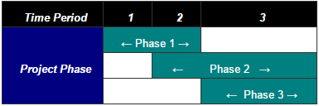
Process phase relationships
Sequential Phase Relationship
When a project has sequential phases, each phase starts after the previous phase is 100% complete
Overlapping Phase Relationship
Sometimes teams need to work independently on different parts of the project, so that one team delivers their results while another team is still working
Iterative Phase Relationship
A project got a single team performing the Initiating and Planning Processes for one phase, while also doing the Executing processes for the previous phase. That way, when the Executing and Closing process groups are finished, the team can jump straight into the next phase’s Executing processes.

Slide 5
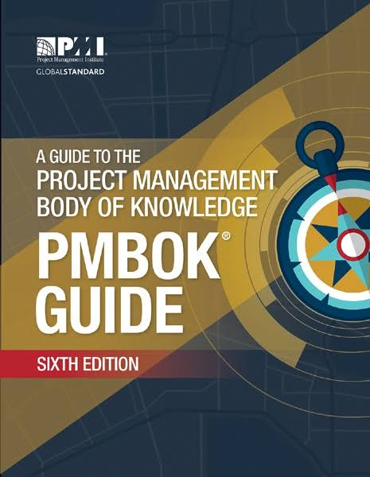
pmbok
Within each process group there are several individual processes that define how actually the work is done in the project
The PMBOK breaks every project down into 49 processes
Each of the processes belongs to only one process groups
Project
Management
Body
Of
Knowledge

Slide 6
Pmbok (some of the 49 processes)
Needs and Initiating Process Groups: (only 2 processes)
Develop Project Charter (agreement)
Identify Stakeholders
Planning Process Groups: (24 processes)
Develop Project Management Plan
Identify Risks
Plan Quality
Estimate Activity Durations
…

Slide 7
Pmbok (some of the 49 processes)
Executing Process Groups: (10 processes)
Direct & Manage Project Execution
Distribute Information
…
Monitoring and Controlling Process Groups: (12 processes)
Control Scope
Monitor and Control Project Work
Control Schedule
Close Project (1 process)

Slide 8
Anatomy of processes
Input
Information that are used in the project
Tools and Techniques
Takes inputs and turns them into outputs
All project work
Outputs
Documents, Deliverables, and Decisions
Helps project come in on time, within budget, and high quality
Input
Output
Process
(Req. Analysis)
Stakeholder
Document
Project Skills
Requirement Specification Document (SRS)

Slide 9
Anatomy of processes
Sometimes the output of one process becomes an input of the next process
The process groups help in organizing the processes by the kind of work that is done
The knowledge areas help in organizing by the subject matter that’s being dealt with
The processes are organized in two ways – the process groups are about how you do the work, and the knowledge areas are there to help you categorize them and help you learn

Slide 10
PMBOK’s Knowledge Areas
1. Integration Management
Making sure all the right parts of the project come together in the right order, at the right time
Coordinating all of the work so that it happens correctly. Making sure changes are approved before they happen
2. Scope Management
Figuring out what work needs to be done for your project. Making sure your end product has everything you said it would.
Scope of timebox to build the system functionality

Slide 11
PMBOK’s Knowledge Areas
3. Time Management
Preparation and Implementation time
Figuring out the time it will take to do your work and the order you need to do it in. Tracking your schedule and making sure everything gets done on time
4. Cost Management
Budgeting for the project
Knowing how much you’re able to invest in the project and making sure you spend it right
5. Quality Management
Making sure that output maintains standard
Making sure you work as efficiently as you can and don’t add defects into the product

Slide 12
PMBOK’s Knowledge Areas
6. Human Resource Management
Efficient use of schedules. Getting the people to work on the team and helping them stay motivated. Rewarding them for a job well done and resolving conflicts that come up
7. Communications Management
Making sure that consistent communications are maintained
Making sure that everybody knows what they need to know to do the job right. Tracking how people talk to each other and dealing with gaps if they happen
8. Risk Management
Figuring out how to protect your project from anything unusual that could happen to it
Risk Management can also be about making sure that you are in the right position to take advantage of the opportunities that come your way

Slide 13
PMBOK’s Knowledge Areas
9. Procurement Management
Selecting the right source for resources
Finding contractors to help you do the work. Setting the ground rules for their relationships with your company
10. Stakeholder Management
Identify the people, groups, or organizations that could impact or be impacted by the project
Analyze stakeholder expectations and develop appropriate management strategies for effectively engaging stakeholders in project decisions and execution

Slide 14
Process group vs. Knowledge Areas
Process groups and Knowledge Areas are two different ways to organize the processes but they don’t really overlap each other!
Process groups divide up the processes by function
Knowledge areas divide the same processes by subject matter
Every process belong to exactly one process group
Every process is in exactly one knowledge area

Slide 15
references
MMH
Bob Hughes and Mike Cotterel (1999). Software Project Management (Second Edition).
PMBOK Guide: Project Lifecycle (5th Edition)

